Slide 1
Editing for Common Errors
SJC South/Laurence Finn
November 16, 2019

Slide 2
Overall Editing Tips
Read your essay backwards
Students often rush when they get closer to the end of a draft
Print your essay
People read printed material slower than electronic; easier to find errors if you’re going slower
Take a break and come back

Slide 3
Ambiguous Pronouns
When using a pronoun (he, she, it), make sure the actual noun it’s referencing is clear.
Example of Ambiguity: “Our patients enjoy the warm days while they last.”
“Jack resents his assistant because he is competitive.”

Slide 4
Active Voice vs. Passive Voice
Active voice involves using a clear subject and verb in your sentence.
“I turned in the essay” is active
Typically, active voice is the best choice, because it is the most specific and carries the most information.
Active voice is more assertive and, in some cases, can be more ethical

Slide 5
Active Voice vs. Passive Voice, cont.
Passive voice eliminates or obscures (“hides”) the subject of the sentence.
“The essay will be written” is passive because it’s missing a subject (like “I”)
If you don’t know who did something, or it doesn’t matter, use passive voice
“My contract was canceled last month” is appropriate since the emphasis should be on “my contract,” not necessarily on whoever ended it

Slide 6
Avoid Wordiness
Replace wordy, cliché phrases with shorter, clearer words:
Due to the fact that = Because
The majority of = Most
Readily apparent = Obvious
A large number = Many
Aware of the fact that = Know

Slide 7
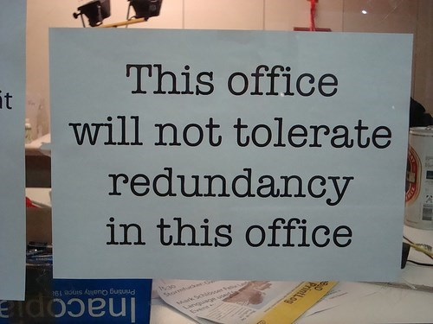
Redundancy

Slide 8
Redundancy, Cont.
When I mark something as “redundant” in your essays, what I mean is that you’ve used multiple words when fewer could work.
Example: “It was a terrible disaster that ruined everything.” Disaster already means terrible, so this is redundant.
Example: “I completely eliminated that bottle with my pistol.” There is no difference between “eliminated” and “completely eliminated,” so remove the adverb.
Phrases like “It’s funny how things play out” or “it’s interesting” can be deleted from your writing, because they don’t add any detail or insight.

Slide 9
Repetition
Writing becomes repetitive when you state the same word, phrase, or idea twice in a short period of time.
“Microsoft Word is helpful for writing essays. Microsoft Excel is great for spreadsheets. Microsoft PowerPoint helps make presentations.”

Slide 10
Weak Verbs
Most errors in clarity result from poor verb choice
Try to think literally: is “have” or “give” the right verb, or can you be more literal and specific?
A lot of times, a noun in the sentence can be converted into a verb.
“I’m going to make a decision shortly” – what’s a better verb here?

Slide 11
Write Positively
Negative writing is harder for a reader to process; try to use positive language.
“Don’t turn in your essay after the deadline has passed.” – this is too negative
“Turn in your essay on time” is a positive form of the same sentence.

Slide 12
Avoid Exaggeration
Words like “always” and “never” should be used sparingly in your writing; often, these are too strong for the situation.
“You never listen to me.” “You always forget to take out the trash.”
Your thesis statements should be firm, but show moderation

Slide 13

Be Specific
What do words like “beautiful” and “rugged” really mean?
Instead of using vague descriptive terms, use specific ones.
A “rugged” car could be one that’s used in rally racing, with 4-wheel drive and improved shocks
Avoid words like “thing” and instead replace them with specific terms
13

Slide 14
Sources/Backup

Slide 15
Sources
Lannon, John M. and Laura J. Gurak. Technical Comunication. 14th ed. New York: Pearson Longman, 2017
Image on slide 7: https://i.chzbgr.com/full/7604174592/h106AA14B/we-deal-with-it-in-a-serious-way-is-how-we-deal-with-it
Image on slide 13: https://m.media-amazon.com/images/M/MV5BNDcyZmFjY2YtN2I1OC00MzU3LWIzZGEtZDA5N2VlNDJjYWI3L2ltYWdlXkEyXkFqcGdeQXVyNTAyODkwOQ@@._V1_SY1000_CR0,0,660,1000_AL_.jpg

